Slide 1
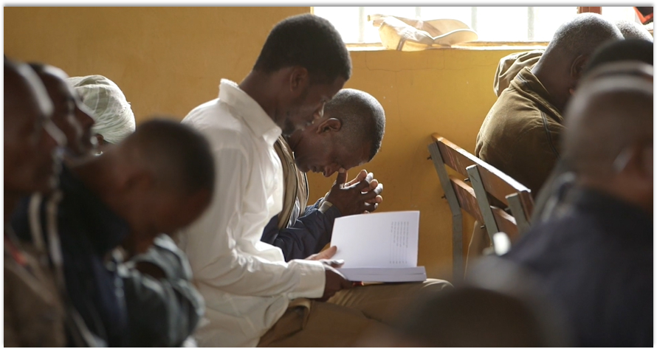
Let us also hold firmly to the hope we confess, for he who promised is faithful (Heb. 10:23).
All Scripture taken from the English Unlocked Literal Bible (ULB), ©2017, 2022 Wycliffe Associates, Available at https://bibleineverylanguage.org/translations, licensed under the Creative Commons Attribution-ShareAlike 4.0 International License.
The English ULB is based on the unfoldingWord® Literal Text, CC BY-SA 4.0. The original work of the unfoldingWord® Literal Text is available at https://unfoldingword.bible/ult/.
Statement of Faith

Slide 2
?
What do you think of when I say the word
“value”?

Slide 3

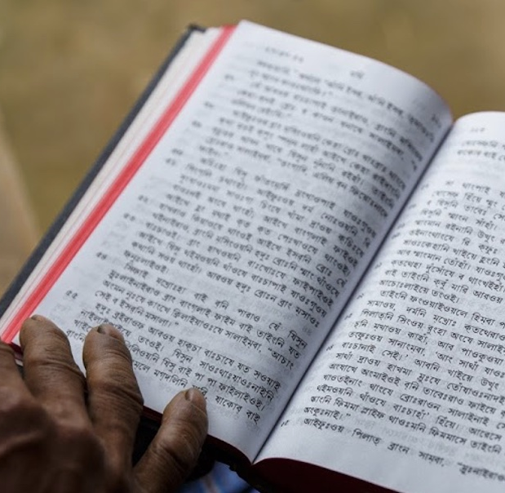
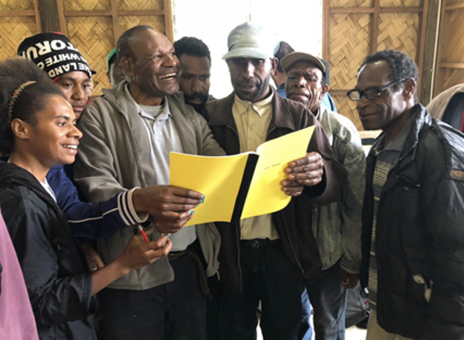
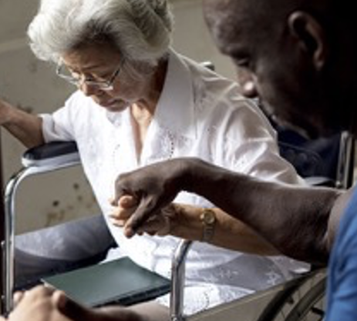
We believe that the Bible is the Word of God.
We believe that the Bible changes lives and advances God’s kingdom.
We believe in the power of the Holy Spirit in the lives of believers.

Slide 4
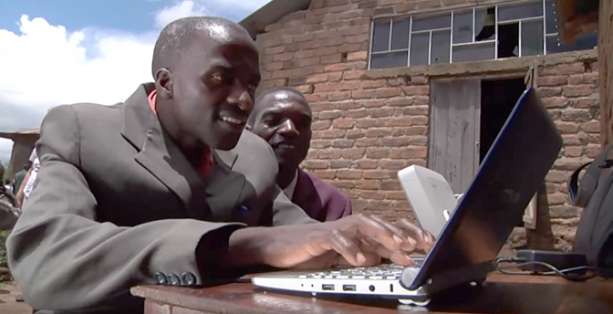
VISION
A Bible in Every Language
MISSION
Involving people
in the advancement of Bible translation

Slide 5
?
How do our vision and mission statement connect with our values?

Slide 6
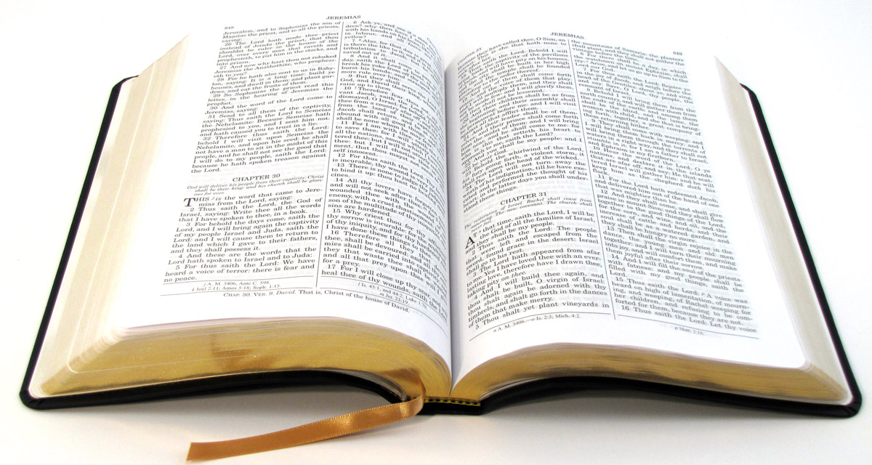
Primary Beliefs
Statement
of Faith

Slide 7
We believe:
The Bible is divinely inspired by God and has final authority.
This means that the Bible came directly from God Himself, and it is completely true. It should be honored above any other source of information.
2 Timothy 3:16: All scripture has been inspired by God. It is profitable for doctrine, for conviction, for correction, and for training in righteousness.
John 17:17: Set them apart by the truth. Your word is truth.

Slide 8
We believe:
2. God is one and exists in three persons: God the Father, God the Son, and God the Holy Spirit.
This means that there is only one God, and He reveals Himself to us in three different roles. He is the Father, He is the Son Jesus Christ, and He is the Holy Spirit.
Deuteronomy 6:4: Listen, Israel: Yahweh our God, Yahweh is one.
John 10:30: “I and the Father are one.”
1 Peter 1:10-11: Concerning this salvation, the prophets who prophesied about the grace that was to come to you searched diligently and examined carefully, ¹¹inquiring into what person or time the Spirit of Christ in them was indicating when he testified beforehand about the sufferings of Christ and the glories that would follow.

Slide 9
We believe:
3. Because of the fall of man, all humans are sinful and in need of salvation.
This means that everyone has sinned, so we are all separated from God. There is nothing we can do on our own to earn eternal life or heaven.
Romans 5:12: So then, as through one man sin entered into the world, in this way death entered through sin. And death spread to all people, because all sinned.

Slide 10
We believe:
4. The death of Christ is a substitute for sinners and provides for the cleansing of those who believe.
This means that Jesus died as punishment for the sins of all humanity. His death counts as payment for us so that we can be forgiven.
1 John 2:2: He is the atoning sacrifice for our sins, and not for ours only, but also for the whole world.

Slide 11
We believe:
5. By God’s grace, through faith, man receives salvation as a free gift because of Jesus’ death and resurrection.
This means that, because of Jesus’s sacrifice, we can be forgiven and saved. We cannot earn this, but we receive it by putting our faith in Jesus.
Romans 3:24-25a: And they are freely justified by his grace through the redemption that is in Christ Jesus. ²⁵For God provided Christ Jesus as an atoning sacrifice through faith in his blood.

Slide 12
We believe:
6. The resurrection of all–the saved to eternal life and the lost to eternal punishment.
This means that everyone will be brought back to life one day. Those who trusted Jesus for salvation will live with him forever. Those who did not trust him will be punished forever.
Acts 24:15: I have a hope in God, which these men also have, that there will be a resurrection of both the righteous and the wicked.
Matthew 25:46: These will go away into eternal punishment, but the righteous into eternal life.

Slide 13
We believe:
The Bible is divinely inspired by God and has final authority.
God is one and exists in three persons: God the Father, God the Son, and God the Holy Spirit.
Because of the fall of man, all humans are sinful and in need of salvation.
The death of Christ is a substitute for sinners and provides for the cleansing of those who believe.
By God’s grace, through faith, man receives salvation as a free gift because of Jesus’ death and resurrection.
The resurrection of all–the saved to eternal life and the lost to eternal punishment.

Slide 14
Statement
of Faith:
Encourages
unity
Focuses
us on what
Is most
important
Provides
a foundation
for working
together

